Slide 1

Introduction
Customer Sales Analysis Project Machine Learning and Tableau
Team B
Team Members
Rebecca Marriott
Nouman Mehar
Suneeta Vota

Slide 2
Project – Customer Purchasing
Utilizing data science in ERP systems enables organizations to offer personalized customer experiences. By leveraging customer data, including purchase history, browsing behavior, and demographics, ERP systems can provide insights into individual preferences, allowing organizations to tailor their marketing efforts, offer personalized recommendations, and improve overall customer satisfaction. This targeted approach enhances customer loyalty and drives revenue growth.
Objective
The primary aim of this project is to predict customer Gender based on their shopping behaviors and other relevant features present in the dataset. Leveraging advanced data analysis techniques and machine learning algorithms, we intend to uncover valuable patterns that will facilitate informed decision-making for businesses

Slide 3
DATASET
Customer Information:
Includes customer details like ID, name, email, phone, address, city, state, zipcode, country, age, and gender. Customer segments are categorized into Premium, Regular, and New.
Transaction Details:
Transaction-specific data such as transaction ID, last purchase date, total purchases, amount spent, total purchase amount, feedback, shipping method, payment method, and order status.
Product Information:
Contains product-related details such as product category, brand, and type. Products are categorized into electronics, clothing, grocery, books, and home decor.
Geographic Information:
Contains location details including city, state, and country. Available for various countries including USA, UK, Canada, Australia, and Germany.
Temporal Information:
Last purchase date is provided along with separate columns for year, month, date, and time. Allows analysis based on temporal patterns and trends.
Data Quality:
Some rows contain null values, and others are duplicates, which may need to be handled during data preprocessing. Null values are randomly distributed across rows. Duplicate rows are available at different parts of the dataset.

Slide 4
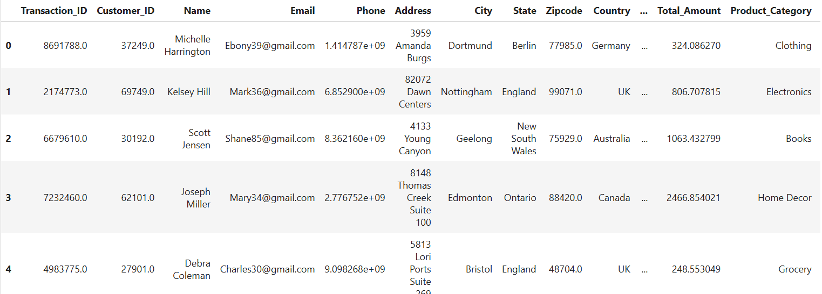

Dataset
Dataset Description:
The dataset represents retail transactional data. It contains information about customers, their purchases, products, and transaction details. The data includes various attributes such as customer ID, name, email, phone, address, city, state, zipcode, country, age, gender, income, customer segment, last purchase date, total purchases, amount spent, product category, product brand, product type, feedback, shipping method, payment method, and order status.
[302010 rows x 30 columns]
Transaction_ID Customer_ID ... Ratings products
0 8691788.0 37249.0 ... 5.0 Cycling shorts
1 2174773.0 69749.0 ... 4.0 Lenovo Tab
2 6679610.0 30192.0 ... 2.0 Sports equipment
3 7232460.0 62101.0 ... 4.0 Utility knife
4 4983775.0 27901.0 ... 1.0 Chocolate cookies
[5 rows x 30 columns]
<class 'pandas.core.frame.DataFrame'>
RangeIndex: 302010 entries, 0 to 302009

Slide 5
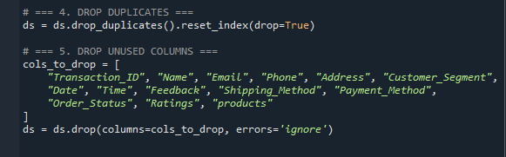
Pre-Processing
For Pre-processing we follow the following steps.
1. Data Collection:
The dataset was sourced from Kaggle, consisting of 302,010 rows and 30 columns.
2. Data Exploration and Understanding:
The initial dataset was printed to understand the structure, including data types, missing values, and duplicates. Duplicate records and irrelevant columns were identified and removed based on domain knowledge and data relevance. After cleaning, the dataset was reduced to 16 columns.

Slide 6
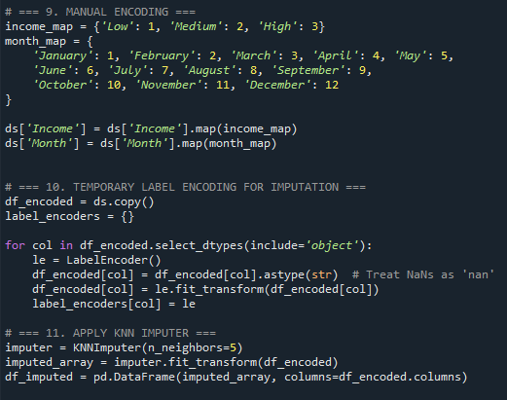
Pre-Processing
3. Handling Missing Data:
Missing values were identified using the isnull() function. To impute the missing values, the K-Nearest Neighbors (KNN) Imputer was employed.
4. Encoding Categorical Variables:
Prior to imputation, categorical variables were encoded as KNN Imputer requires numerical inputs. Manual encoding was applied to columns with a small, manageable number of categories. For the remaining categorical variables, Label Encoding was used to convert them into numeric format.

Slide 7
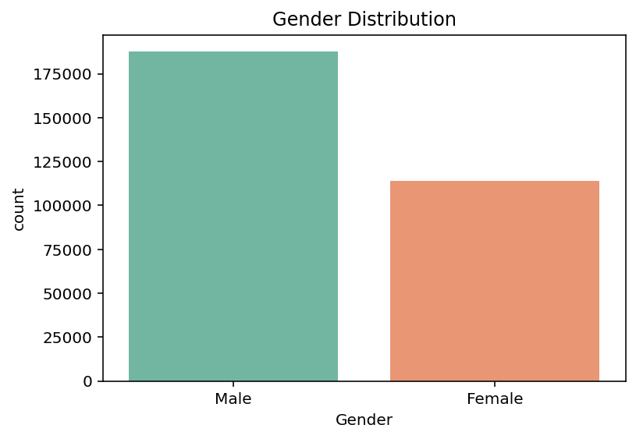
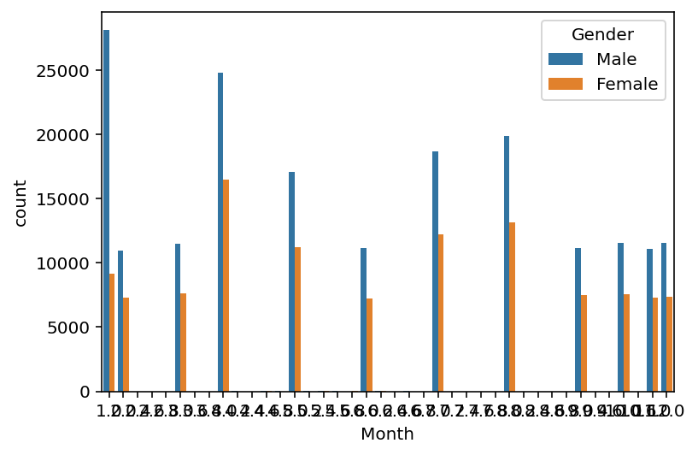
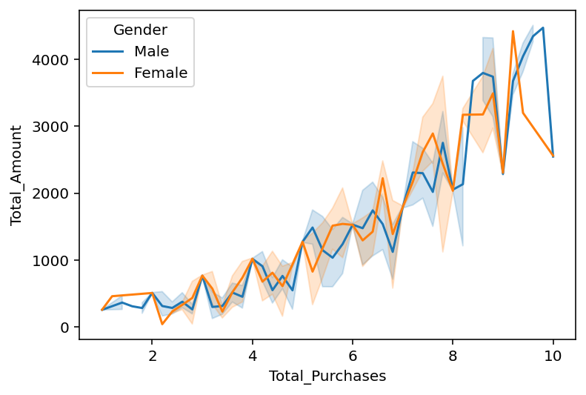
Pre-Processing
5. Decode Back To Original Categories:
Post-processing, the label-encoded categorical columns were decoded back to their original string labels to enhance interpretability during data visualization.
6. Visualization:
Bar Plot
Comparison between male and female customers
Line Plot
Comparison between male and female total purchases
Bar Plot
Comparison between male and female spending's monthly wise

Slide 8
Data Modelling
Logistic Regression – Balanced
Random Forest
KNN k=3

Slide 9
Model | Accuracy | F1-Score (Male) | F1-Score (Female) | Notes
Logistic (raw) | 62% | 0.00 | 0.77 | Biased to Female
Logistic (balanced) | 52% | 0.45 | 0.57 | Better class balance
SMOTE + Logistic | 53% | 0.44 | 0.59 | Slight improvement
Random Forest | 59% | 0.22 | 0.73 | Struggles with Males
XGBoost | 56% | 0.01 | 0.77 | Worst male recall
KNN (k=3) | 55% | 0.36 | 0.65 | Balanced but moderate

Slide 10
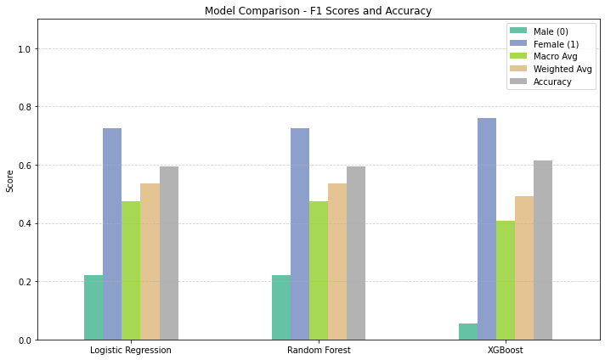
MODEL COMPARISION CHART

Slide 11
Logistic Regression - Balanced

Slide 12
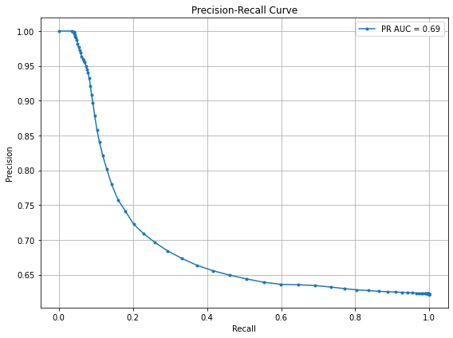
LOGISTIC REGRESSION – BALANCED
Precision-Recall Curve - Important when one class dominates
Value counts:
Gender
Male 187596
Female 114093
This evaluates how well the model performs, especially when dealing with imbalanced classes.
AP (Average Precision): The area under this curve, AP = 0.69 in this case - the model maintains moderate precision across varying levels of recall.
This is significantly better than random (which usually gives a low AP.
It suggests your model has some predictive power, even if the ROC AUC was low (0.54).

Slide 13
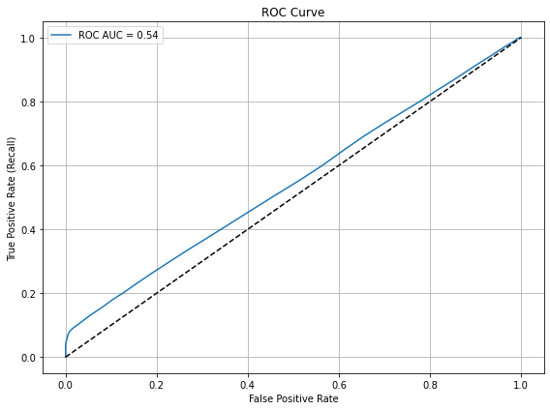
LOGISTIC REGRESSION – BALANCED
ROC Curve - Especially useful for class imbalance — this shows performance tradeoffs
This shows the model's ability to distinguish between classes (e.g., predicting gender).
AUC Score = 0.54
AUC (Area Under Curve) ranges from 0 to 1:
0.5: Random performance.
1.0: Perfect classification.
< 0.6: Very poor performance.
0.54: This is only slightly better than random. The model is not effectively distinguishing between the classes.

Slide 14
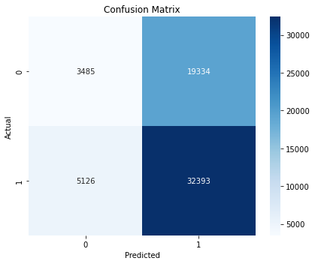
LOGISTIC REGRESSION – BALANCED
Confusion Matrix - actual vs. predicted class counts
The model is heavily biased toward predicting “Female (1)”
It correctly identifies most females, but struggles with males — often misclassifying them as female
Out of 22,819 actual males, only 3,485 were correctly predicted → that’s very poor performance for class 0 (Male
The model is much better at identifying Female (1) than Male (0)

Slide 15
Random Forest

Slide 16
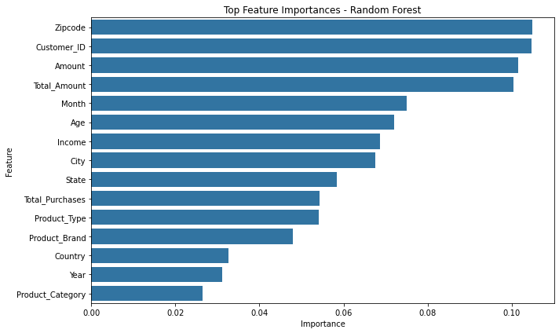
RANDOM FOREST
Feature Importance Plot - This will show which features are driving the model's predictions
This ranks features based on their importance in the Random Forest model.
Higher values mean the feature contributes more to the model's predictions.
The most important features are:
Zipcode
Customer_ID
Amount
Total_Amount

Slide 17
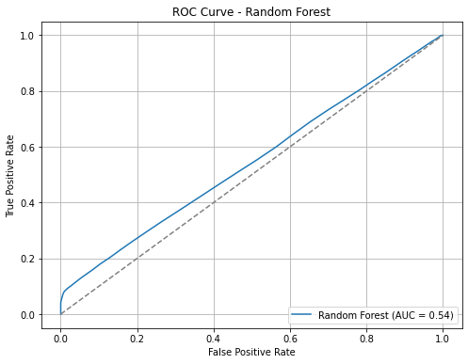
RANDOM FOREST
ROC Curve - Especially useful for class imbalance — this shows performance tradeoffs
This shows the model's ability to distinguish between classes (e.g., predicting gender).
AUC Score = 0.54
AUC (Area Under Curve) ranges from 0 to 1:
0.5: Random performance.
1.0: Perfect classification.
< 0.6: Very poor performance.
0.54: This is only slightly better than random. The model is not effectively distinguishing between the classes.

Slide 18
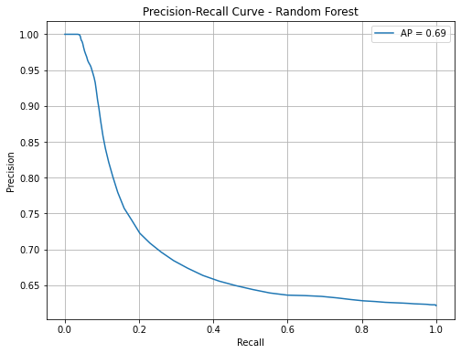
RANDOM FOREST
Precision-Recall Curve - Important when one class dominates
It evaluates how well your model performs, especially when dealing with imbalanced classes.
AP (Average Precision): The area under this curve, AP = 0.69 in this case - the model maintains moderate precision across varying levels of recall.
This is significantly better than random (which usually gives a low AP, often near the positive class ratio).
It suggests your model has some predictive power, even if the ROC AUC was low (0.54).

Slide 19
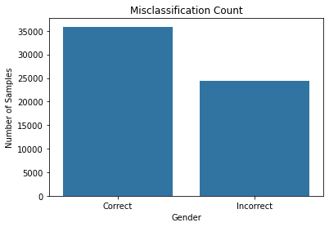
RANDOM FOREST
Misclassification Analysis - bar chart of correct vs. incorrect predictions
Correct Predictions: Represented by the left bar, with a height around 36,000. This indicates the number of samples where the Random Forest model predicted gender correctly
Incorrect Predictions: Represented by the right bar, with a height around 24,000. This indicates the number of misclassified samples—i.e., where the predicted gender did not match the actual gender
The Random Forest model made more correct predictions than incorrect ones, suggesting it performs reasonably well.

Slide 20
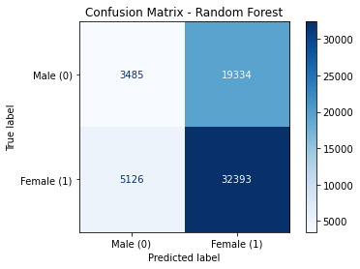
RANDOM FOREST
Confusion Matrix - actual vs. predicted class counts
The confusion matrix shows the performance of the Random Forest model on gender classification where:
0 = Male
1 = Female
True Positives (TP): 32,393 — Female correctly predicted as Female
True Negatives (TN): 3,485 — Male correctly predicted as Male
False Positives (FP): 19,334 — Male incorrectly predicted as Female
False Negatives (FN): 5,126 — Female incorrectly predicted as Male
High accuracy for Females:
Recall = 86.3%
Poor performance for Males:
Recall = 15.3%

Slide 21
KNN k=3

Slide 22
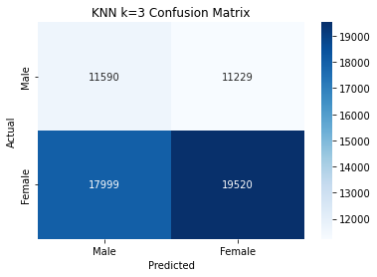
KNN k=3
Confusion Matrix - actual vs. predicted class counts
Accuracy: 55% This means the model predicted the correct gender 55% of the time on the test set.
This shows the model is relatively balanced, but its predictive power is weak for both classes, especially due to the high number of false positives/negatives.

Slide 23
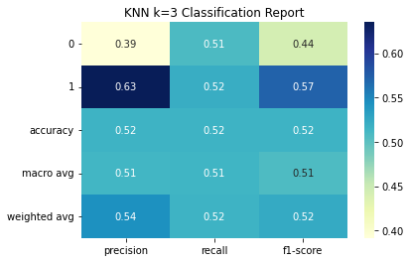
KNN k=3
Confusion Matrix - actual vs. predicted class counts
Class 0 = Male
Precision: 0.39 (many false positives)
Recall: 0.51 (barely half the actual males are correctly predicted)
F1-score: 0.44 (low overall performance)
Class 1 = Female
Precision: 0.63 (relatively better)
Recall: 0.52
F1-score: 0.57
The model is moderately biased towards predicting females.

Slide 24
Evaluation

Slide 25
Models Used: Logistic Regression (with balancing and SMOTE), and Random Forest.
Class Imbalance: Clearly recognized and addressed with SMOTE and evaluation via precision-recall curves.
Performance:
AUC scores ~0.54 for both models—barely better than random, suggesting limited predictive power.
High bias toward female predictions; male recall extremely low (~15%).
Random Forest outperformed Logistic Regression in overall correct predictions (~60% accuracy).
Clear Objective: Predict customer gender using shopping behavior and related features—relevant for personalized marketing and customer segmentation.
Comprehensive Scope: Incorporates data science, machine learning, and Tableau for a full analytics lifecycle.

Slide 26
Areas for Improvement
Model Performance: AUC of 0.54 is low; model does not generalize well. Consider feature engineering, hyperparameter tuning, or trying other classifiers (e.g., XGBoost).
Bias Handling: Strong gender prediction skew—more robust balancing or ensemble techniques may help.
Feature Importance: High importance of ZIP code and Customer ID is questionable—potentially indicates data leakage or overfitting.

Slide 27
TABLEAU

Slide 28
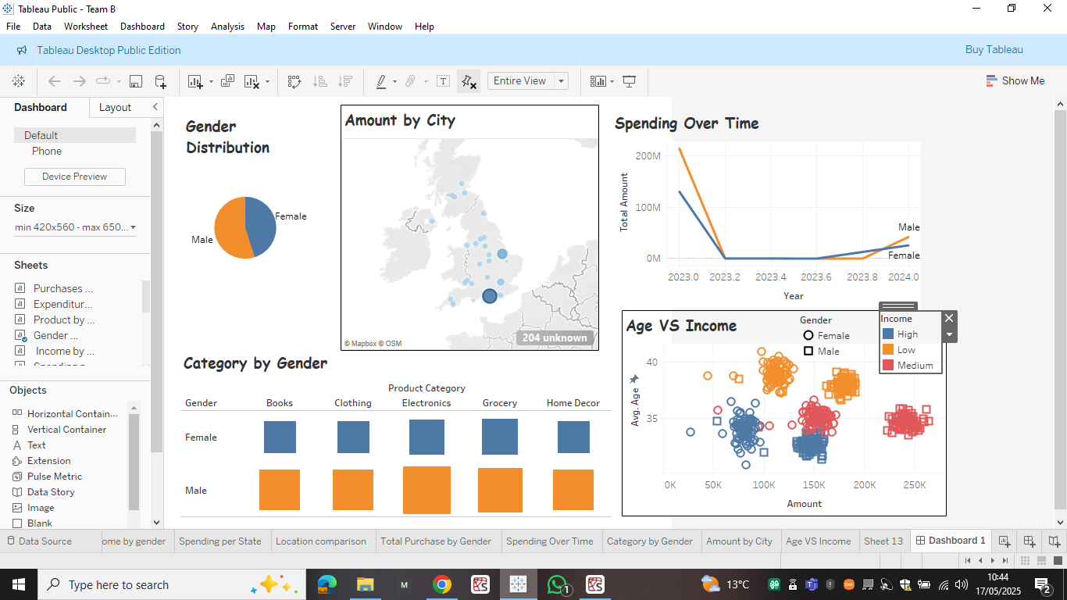
CUSTOMER SPENDING ANALYSIS DASHBOARD

Slide 29
CUSTOMER SPENDING ANALYSIS DASHBOARD
Insights by Gender, Income, Category, and Time
Gender Distribution
Pie chart shows an unequal distribution between Male and Female consumers.
Balanced representation ensures fair analysis across genders.
Important for marketing and segmentation strategies.
Spending Over Time
Timeline from 2023 to 2024.
Observation:
High spending peak in early 2023, followed by a dip and gradual increase into 2024.
Males have slightly higher total amounts towards 2024.
Implications:
Possible seasonal effects or market events.

Slide 30
CUSTOMER SPENDING ANALYSIS DASHBOARD
Insights by Gender, Income, Category, and Time
Amount by City
Map visualisation shows spending concentration by city.
Observation:
Major cities have higher spending (indicated by larger circles).
London and surrounding areas show a dominant share.
Product category preferences segmented by gender
Males outnumber females in all the listed product categories, however, if we consider the gender imbalance, then we can assume that There is no significant difference between male and female engagement.

Slide 31
CUSTOMER SPENDING ANALYSIS DASHBOARD
Insights by Gender, Income, Category, and Time
Age vs Income Analysis
Scatter plot analysis with filters for Gender and Income Levels.
Key insights:
High-income individuals mostly spend around the 150K mark.
Younger individuals (30–35 age group) contribute significantly to spending.
Key Takeaways
Gender preferences vary significantly by product category.
Spending over time shows a recovery trend in 2024.
Income and age play vital roles in determining spending behaviour.
Regional spending insights can support targeted campaigns.

Slide 32
Business Recommendations
1. Improve Customer Segmentation:
We can use customer demographics (age, gender, income, region) to create targeted marketing promotions. This helps design personalized promotions for each group, especially high-spending peoples which age range from 30 to 35.
2. Optimize Inventory Based on Gender Preferences:
Align stock levels and promotional focus in high-performing regions (e.g., London) with those trends to minimize overstock and maximize sales.
3. Make the Model Better:
Current model accuracy is 0.54% which is good but can be improved. We can balancing the data more to get the better accuracy.

